Slide 1
Corruption, Risk, & Foreign Investment
QM 2023 Capstone Project
Arjun Daemian Kade Isidro
Daemian’s attempt

Slide 2
Research Question
How do perceived corruption and geopolitical risk affect foreign direct investment?
What was analyzed: CPI + GEPU
How was it analyzed: Causal inference using panel econometric methods, with an emphasis on methodological constraints

Slide 3
Data Sources
Sample set of 20 countries over 13 years from 2012 to 2024, culminating in 237 observations
Sources:
Corruption Perceptions Index (CPI) – Transparency International
Geopolitical Risk Index (GEPU) – Caldara & Iacoviello
Foreign Direct Investment (FDI) – World Bank
Crime Index – Numbeo (See Slide
Outcome: FDI inflows (signed-log transformation)

Slide 4
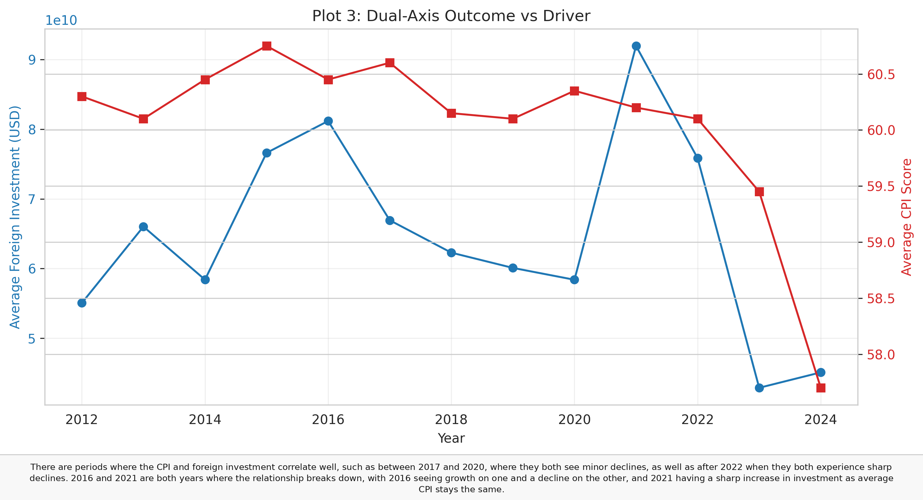
M2: Exploratory Data Analysis
Approach: Correlation, time-series plots, group heterogeneity
Key Findings:
Weak positive correlation between CPI and FDI (r ≈ 0.14)
Suggested optimal lag: 12 for economic relationships (later shown infeasible)
China as outlier: much higher CPI than other data points
Crime no longer considered an important factor within exploratory correlation
Data Quality Flags
Some countries missing 2025 data, led to analysis of 2012 to 2024 instead of 2025
China’s heterogeneity was noted as a potential issue.

Slide 5
M3: Econometric Specification
Model: Two-way fixed effects (country + year dummy variables)
Key Design Decisions:
Outcome: fdi_slog (signed-log transform; handles negative values)
Main driver: cpi_score_lag1 (one-year lag CPI)
Control: gepu (geopolitical uncertainty; time-varying)
Robust Ses: Clustered at country level
Lag Specification Issue:
M2 identified lag=12 as optimal, but only 13 years of observable data meant that a 12-year lag would remove all observations. Instead, 1-, 2-, and 3-year lags were tested as alternatives

Slide 6
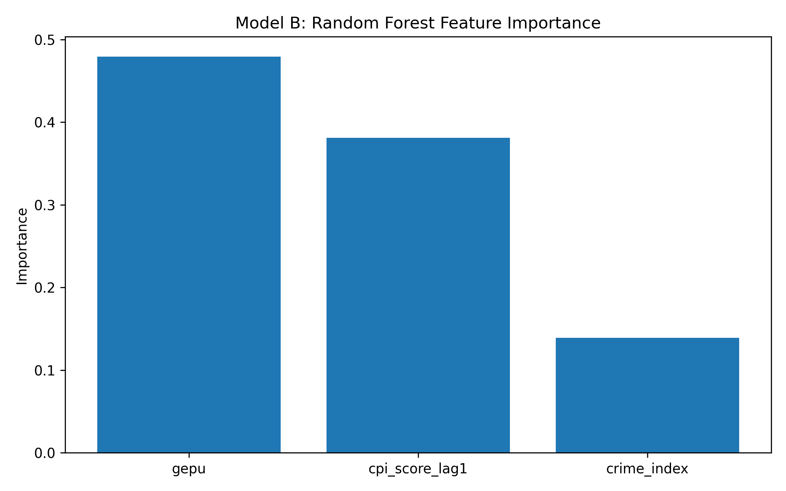
M3 Primary Findings
Model A: Two-way fixed effects
Both CPI and GEPU were found to be not significant, answering the questions definitively.
The model itself was a bad fit, only explaining a small amount of variation and showing that the greatest drivers were not present in the data set
Model B was no improvement, giving us slightly worse results with a loss of interpretability

Slide 7
Possible Instability: 2020 Pandemic Shock
Baseline: coefficient = -0.2444, p = 0.1536
Excluding 2020: coefficient = -0.2229, p = 0.3151
The coefficient reduction when the pandemic year is removed suggests that COVID had almost no real impact on our results. Regardless of this lack of shock, our results are still not significant and leave the conclusion unchanged.

Slide 8
Robustness Checks
Alternative lags (1, 2, 3 years):
- Lag 1: coef = -0.1135, p = 0.4238
- Lag 2: coef = -0.1149, p = 0.4765
- Lag 3: coef = -0.2444, p = 0.1536
Crime-Based Subsamples:
Our crime-samples were insignificant, with no real bearing on investment
Clustered vs. Non-clustered SEs:
Both clustered and non-clustered SEs had similar results, leaving the conclusion unchanged for both assumptions.

Slide 9
Limitations & Caveats
Omitted Variables (Major drivers missing):
A lack of variables like GDP growth, interest rates, trade openness, and tax policy limited our analysis.
Measurement Error:
Our data is based on different forms of measurement, from more social measurements to broad datapoints
External Validity:
Only 20 Countries with complete overlap means that our results may not generalize for other periods or untested regions
Endogeneity:
Analyzing only the effect of corruption on investment does not approach how FDI could improve governance

Slide 10
What happened to the crime data?
The crime data was considered time-invariant within individual countries, without considerable change between years
As we ran our regression, it was absorbed by the other time-invariant differences, and as such obtained a VIF of 6.56, meaning that the model failed to estimate the impact of crime on FDI.
Our solution to this issue was to exclude it from the main analysis
However, we kept it in our robustness checks and the Random Forest.

Slide 11
Our Conclusions
Main finding: Corruption (CPI) effect on FDI is not statistically significant
Policy Implication:
Corruption reform matters for governance, but FDI also depends on macroeconomic stability, uncertainty, and larger institutions, meaning that anti-corruption actions alone will not greatly improve foreign investment
Methodological Learning:
Criminal data collected but was inapplicable in FE framework and we had a limited causal lag when compared to correlative lag

Slide 12
Recommendations for Future Work
Extend our length of time:
Our short timespan, limited by the youth of several of our data sources, greatly impacted our ability to implement greater lags and gave us small amounts of data to work with.
Add macroeconomic controls:
Including controls like GDP growth or exchange rates would allow a greater analysis of the economy and what exactly causes it to change, also giving us a greater insight into how corruption could affect economies.
Alternative methods:
Using instrumental variables and running random effects models to estimate crime effect could be different ways to approach our question.
Qualitative Research:
If possible, interviewing multiple investors on how corruption affects FDI could provide insights.

Slide 13
Key Takeaways
What we learned:
From M2, it appears that corruption matters qualitatively for investor confidence, but M3 proves that it is not a major causal force in the time span of our analysis
Why?
Missing macro drivers and our inability to test the lag shown in M2 could both have poorly affected our findings.
Next steps:
Getting longer data and macro controls might allow us to analyze the causal question with more confidence, showing that our data could be an exploratory foundation of how corruption affects investment.

